Slide 1
Costume Clash
Team Pitch
by Luke Bell, Sam Bagshaw, Sujai Bhuiyan, and Charlie Ashall
Notes:
Summary for Clash of Cos:
Top-Down Action game
Target Audience – 12+ gamers (silly, but skill level helps)
For PC

Slide 2
Team Introduction
Luke Bell
Team lead and UI
Sam Bagshaw on Level Design
Sujai Bhuiyan on Research & asset acquisition
Charlie Ashall on Mechanic Creation/ implementation

Slide 3

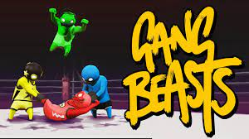
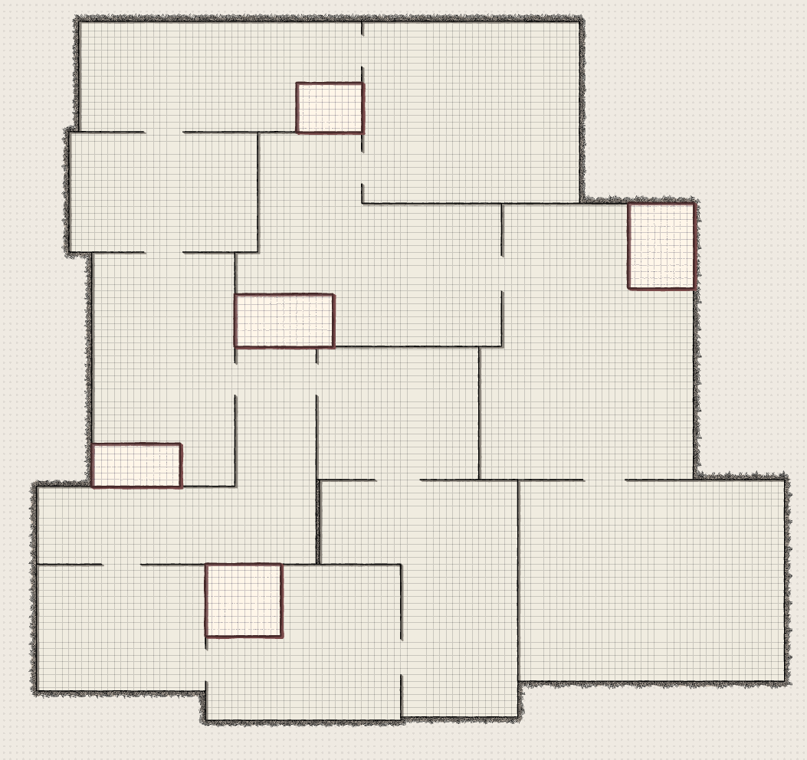
Overview of Presentation
Summarise talking points:
Research & Inspiration
Gameplay
Level Design
Conclusions
Questions and Recommendations
Notes:
Summary of talking points:
Research & inspiration
Gameplay
Level design
Conclusions
Questions and Recommendations

Slide 4
Research and Inspiration

Slide 5
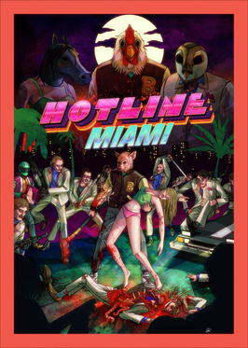
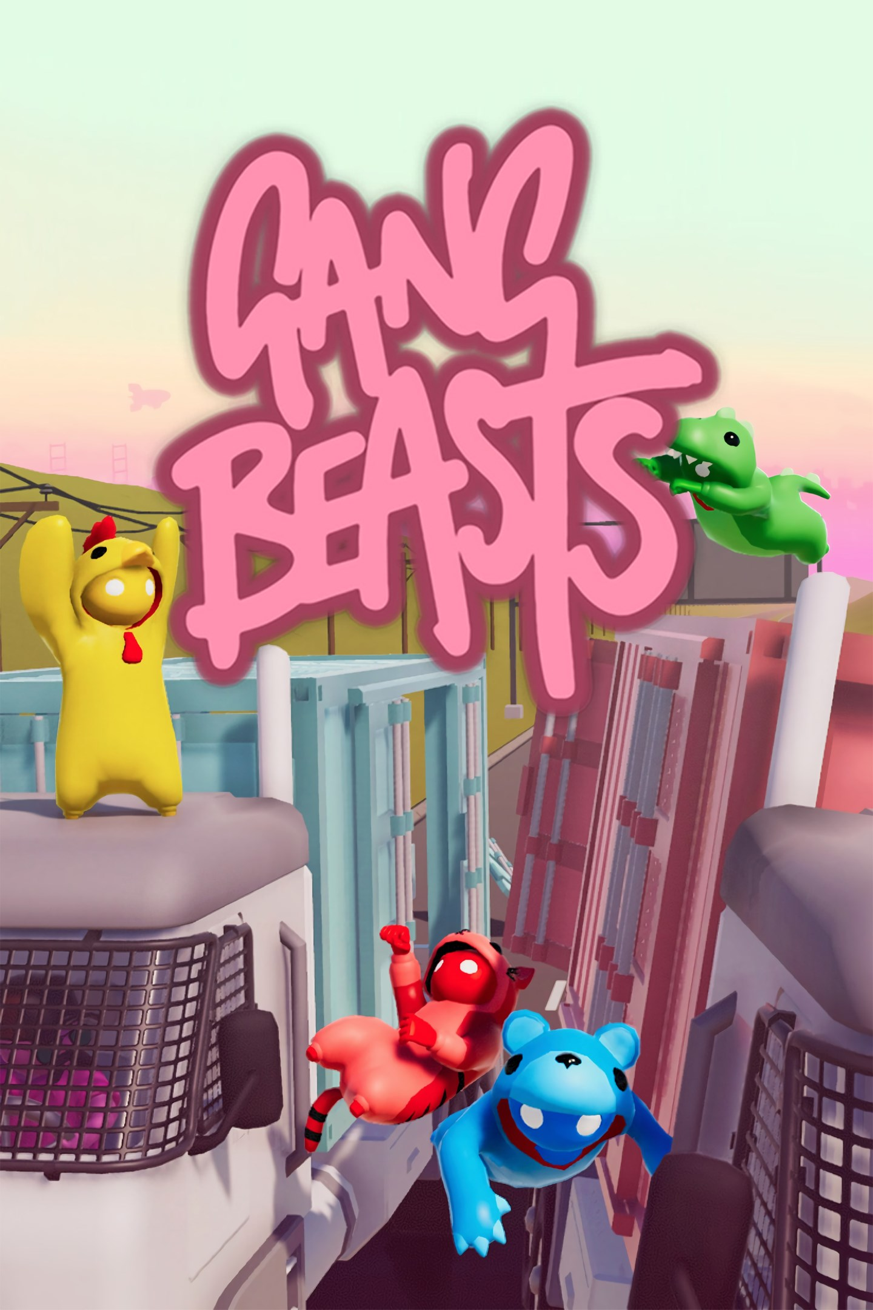
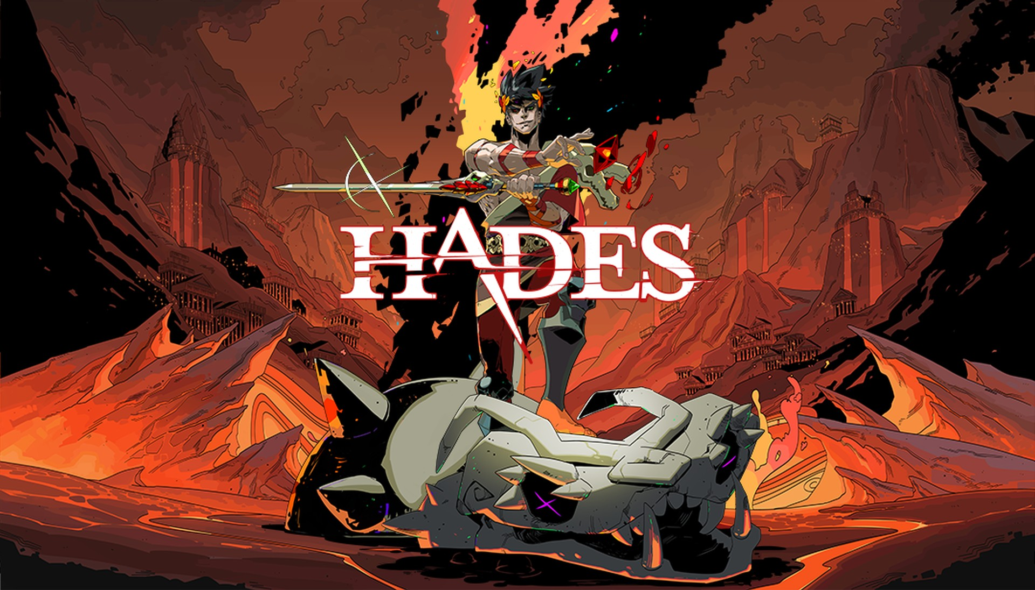
Concept-Genre Inspiration Mash
Hotline Miami -
Gang Beasts -
Hades –
Mythology
Comic con
Project Goal is to produce am intense slap stick physics fight
Untapped Market
Notes:
Fast top-down action game – Hotline Miami (we wanted to combine the balls to wall action of Hotline with the wacky physics of games like Gang Beasts)
Gang Beasts (the most popular of physics fighters made it the easiest to draw inspiration from)
Hades – inspired the inclusion of fake (trashy) "gods" into the narrative to appear as bosses, that due to the wacky tone of the game still give items (a combination with similarity to Isaac).

Slide 6
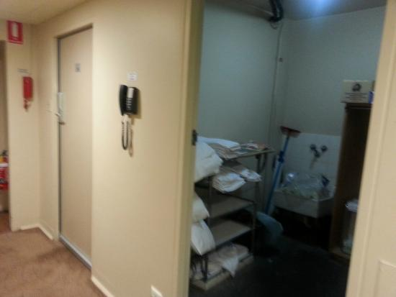
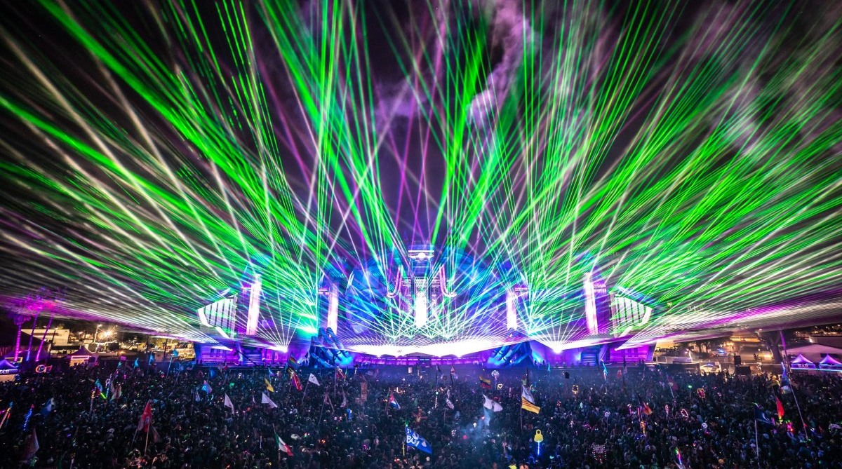
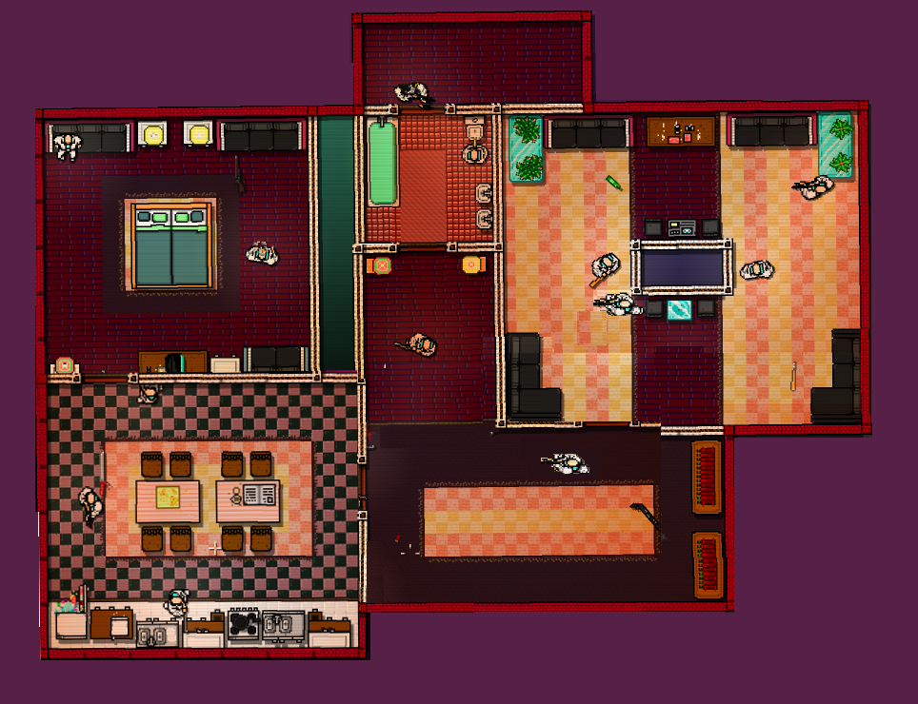
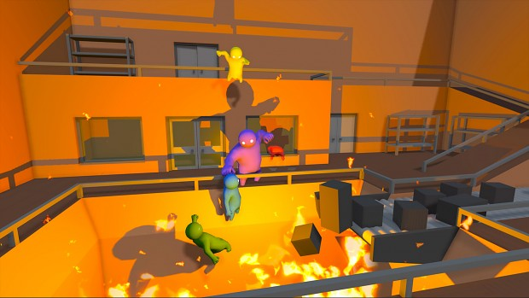
Environment Inspiration
Our environment is an abandoned hotel, turned party fight club. We researched hallways and different establishments:
Hotels
Restaurants
Spas
Raves
Storage rooms
Style
Notes:
What was the process of your research?
The process we went through was that the idea/inspiration was an abandoned hotel and we went for this specific theme because of my college sam decision and I was mainly following my designers choices.
What props and research did you go and get it from?
Taser, Waiting room, Table, plates etc
Where are materials/textures?
We were implicate materials but we didn’t get the too as one files went missing and lost a good amount of progress due to the computer crash sometimes

Slide 7
Gameplay and Mechanics

Slide 8
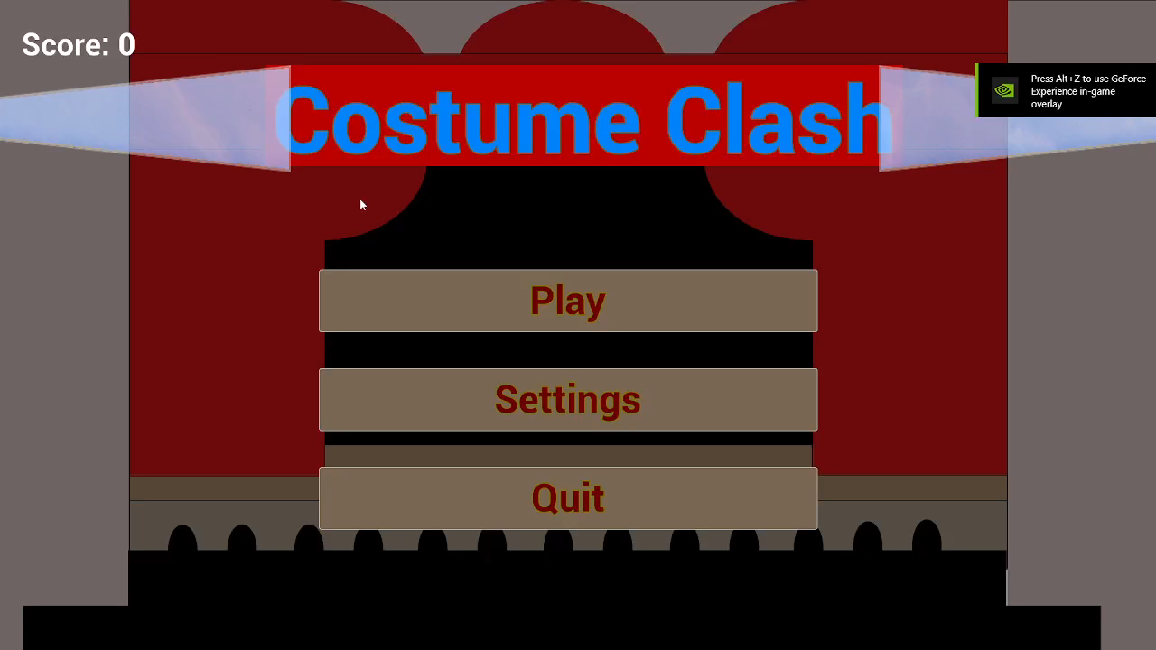
Gameplay Mood-board/Video/Example
Video Link: https://youtu.be/TzfO3IDE5dQ

Slide 9
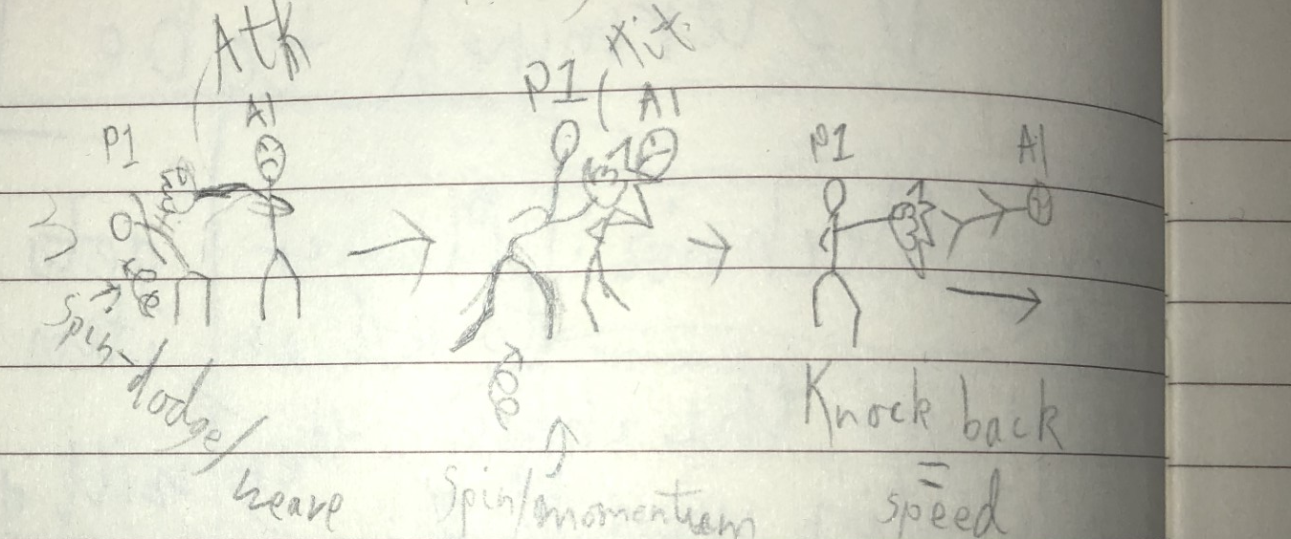
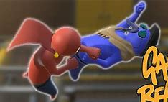
Core Gameplay Inspiration and Design
We modelled our attacks and dodges on Gang beast
Weave/dodge swing/attack ragdoll/knockback/damage
Physics fighter skill momentum.
This game hopes to combine that with high speeds and the corresponding dynamic decision-making. Resulting in a wacky game with the unexpectedly high technical skill ceiling
Notes:
Physics can be surprisingly technical, dodging then using that momentum to attack. That is what we wanted for ourselves.

Slide 10
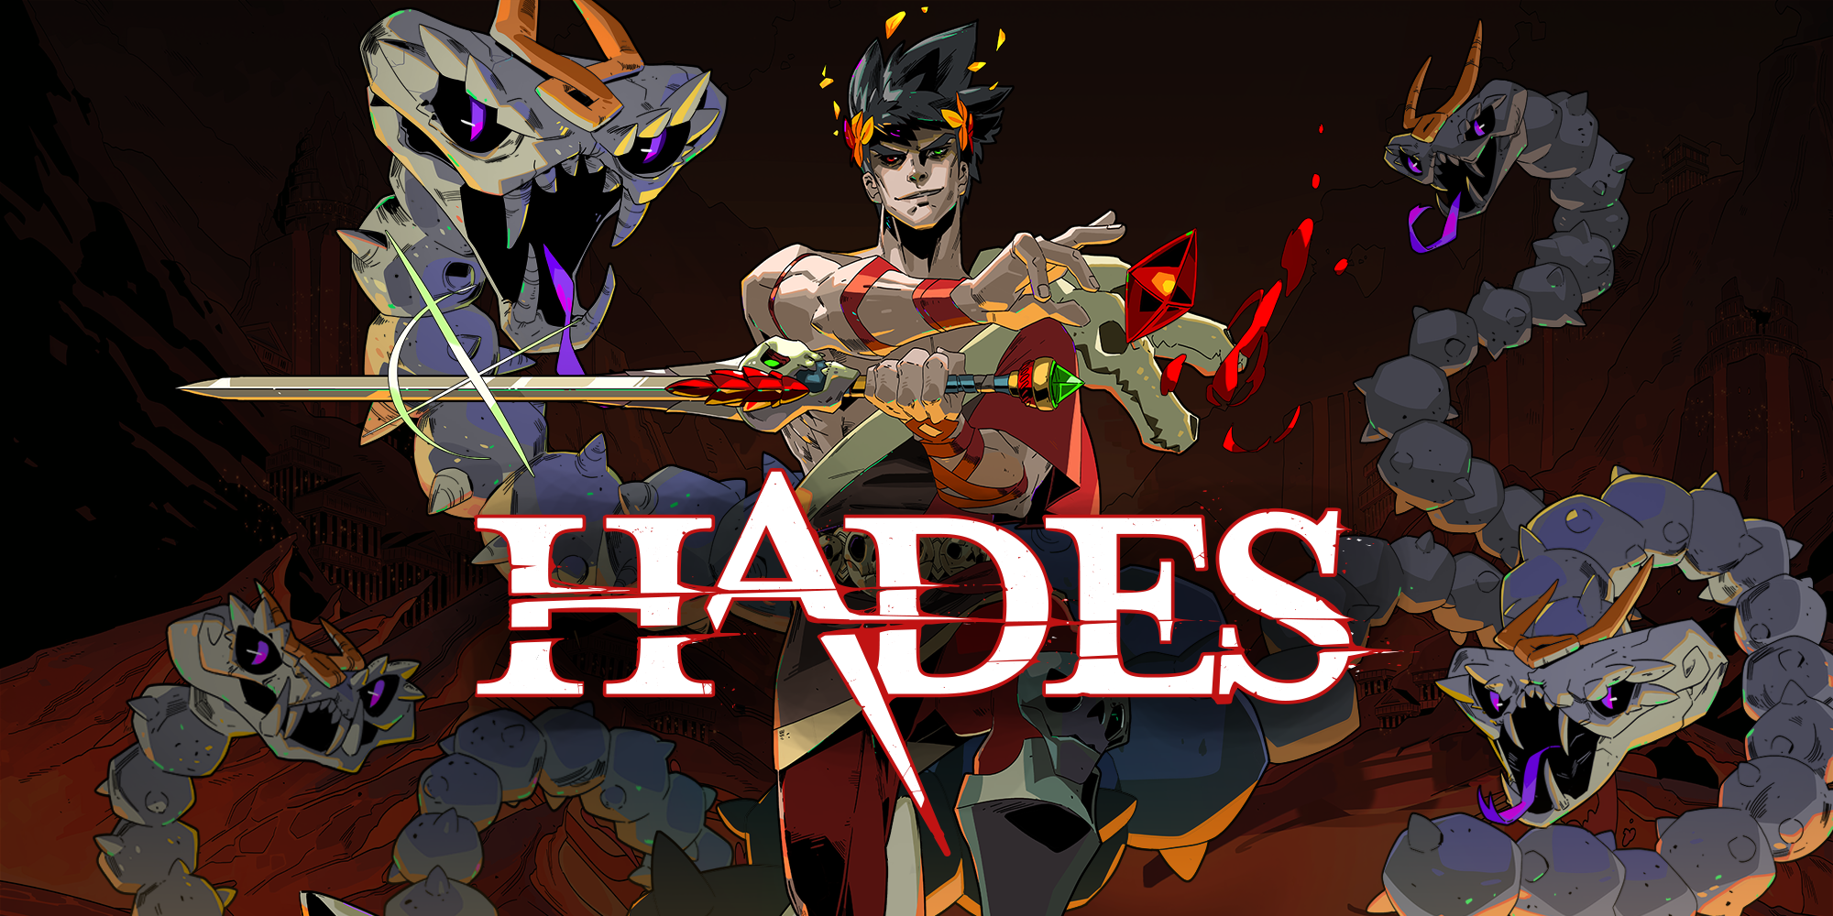
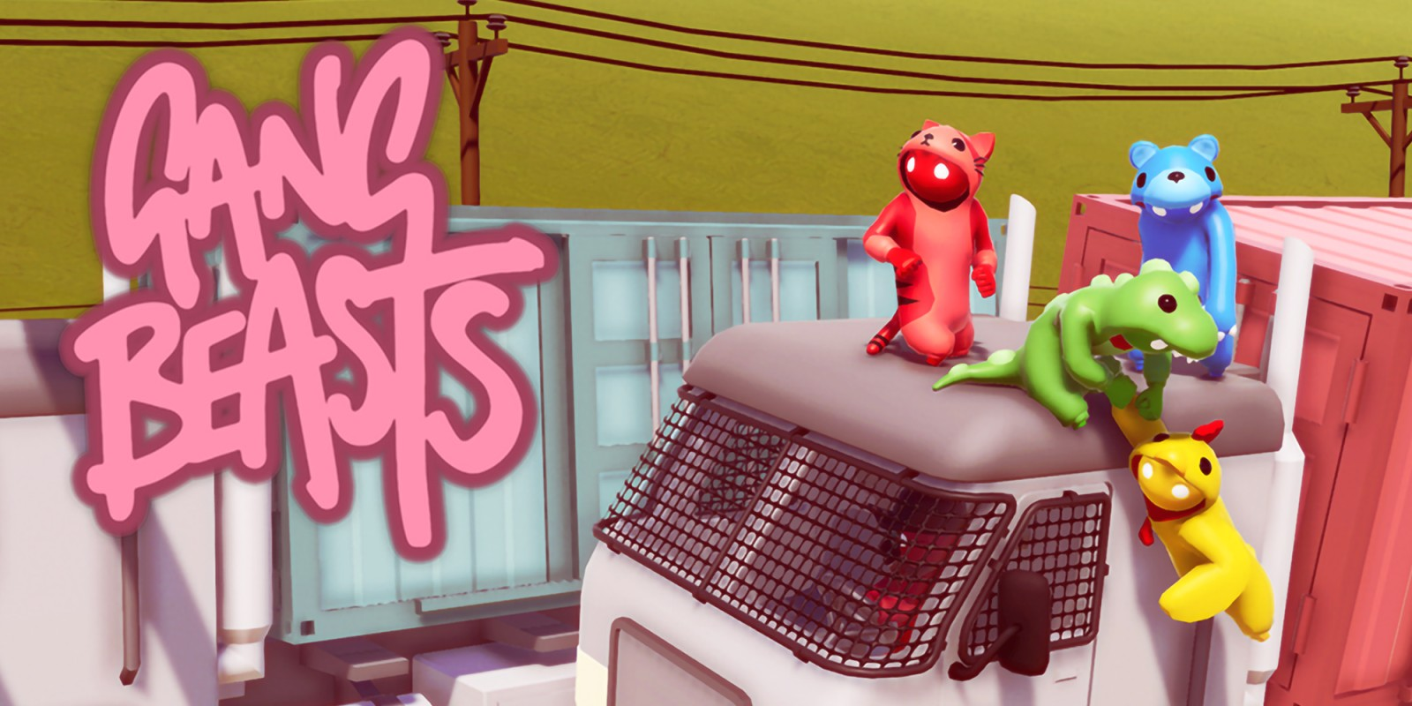
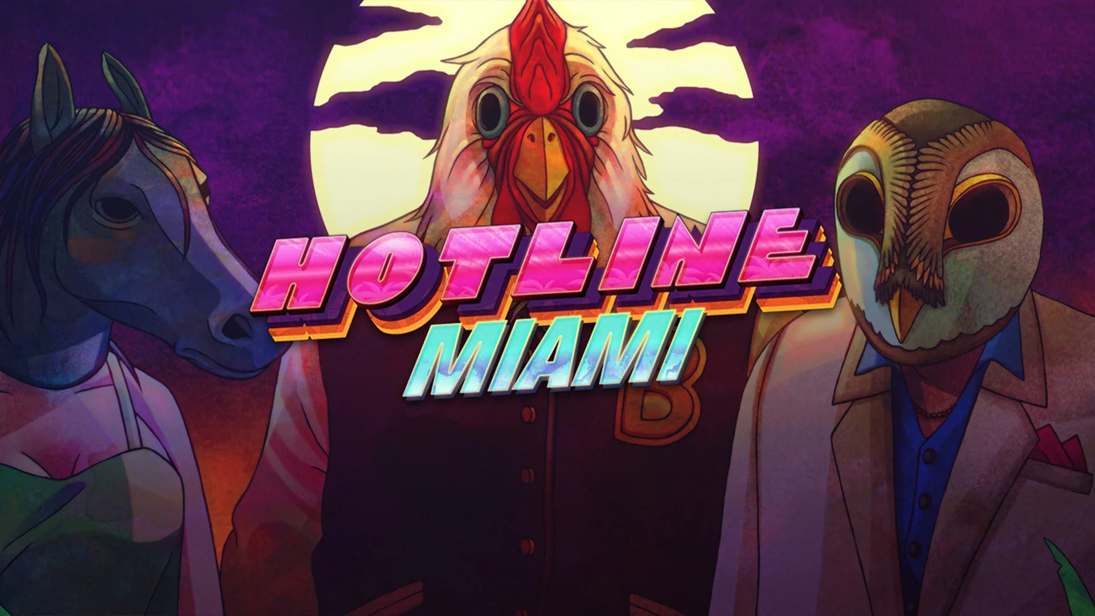
Core Gameplay Implementation & Research
Punching was done using a hitbox on the character fist and a simple animation
We looked at adding/working around mechanics like the powers/upgrades you would get in Hades, and the ragdoll fighting from Gang Beasts
A stun feature was done by making a projectile that can be makes the enemy stuck in a stun animation if hit
Notes:
When we started our research, we investigated popular top-down games such as Hades and Binding of Issac. One of these games main mechanics were the abilities/powers they could use against enemies or use to upgrade their characters speed or power. We also investigated games like gang beasts, which has a unique and comedic combat system. The player characters fight each other with a ragdoll like element where the players arms flail around punching each other and go limb when knocked out so they can be picked up and thrown around, which added a comedic element.
With our game, we wanted that comedic ragdoll element as well as the top-down combat with unique abilities form the ‘cosplay gods’ to also add on to the comedic effect. One of our mechanics was to make a simple animation to raise the player characters arm, to which the player must then move their character around to swing the arm to hit enemies. A hitbox was attached the characters arm so when the player clicked the mouse, the hitbox would activate so when it overlapped with an enemy character, it would deal damage and activate the enemy's ragdoll and send them flying back from colliding with the characters arm. We also worked one some of the abilities such as ‘zeus’ lighting. This would work by making the player shoot at an enemy which makes them go into a stun animation and leaving them open for the player to attack.
What: ragdoll punches uses unreal physics and collision boxes
Why: method of using sockets and collision boxes was accessible and worked well with mesh physics
How: unreal Ragdoll physics and mesh sockets to attach collision boxes to apply damage
Alternative: Use a velocity damage filter to apply damage/knockback
at an enemy which makes them go into a stun animation and leaving them open for the player to attack.

Slide 11
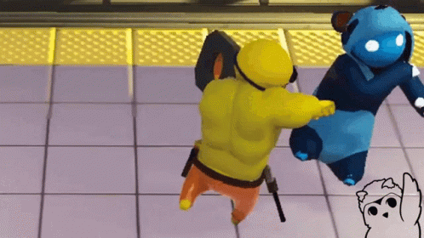
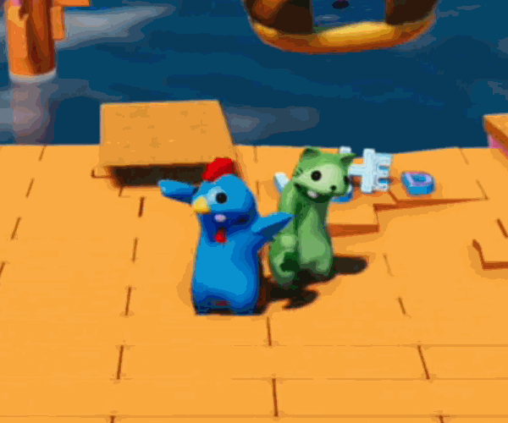
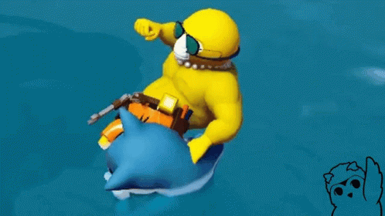
Knock back Implementation & Research
The knockback for the enemies worked by using the static mesh momentum
Intended as double edge sword
The punch animation made momentum easier to aim/use on enemies
Notes:
The knock back element was a simple implement to add as it worked as a Collison. For example, in gang beasts when players hit each other, they get knocked back based on the force/momentum of the attack. As our main mechanic worked with the player needing to swing their arm around to attack enemies, the Collison between their arm and the enemy was enough force to cause a comedic knockback on enemies when they go into ragdoll. The same was also true if an enemy was hit with a punch with little force, so they wouldn't fly back a large distance, making a good physics and Collison system.
However, we did have issues such as enemies being stuck on the player when hitting them. This was an easy fix as we just needed to arrange the ragdolls a little so they wouldn’t become stuck on the player character and would instead be knocked down or knockback by the punch. We also wanted to add a power that would give a greater knockback but decided against it due to both time and focusing on other effects.
The knockback acts as a double edge sword
It gives the player more time (also considered ways to kill with it) but also makes finishing enemies off more difficult when fighting multiple
This is true for enemies as well. Knocking the player back could disrupt and panic them. But it also gives the player time to get up before being surrounded by multiple enemies.

Slide 12
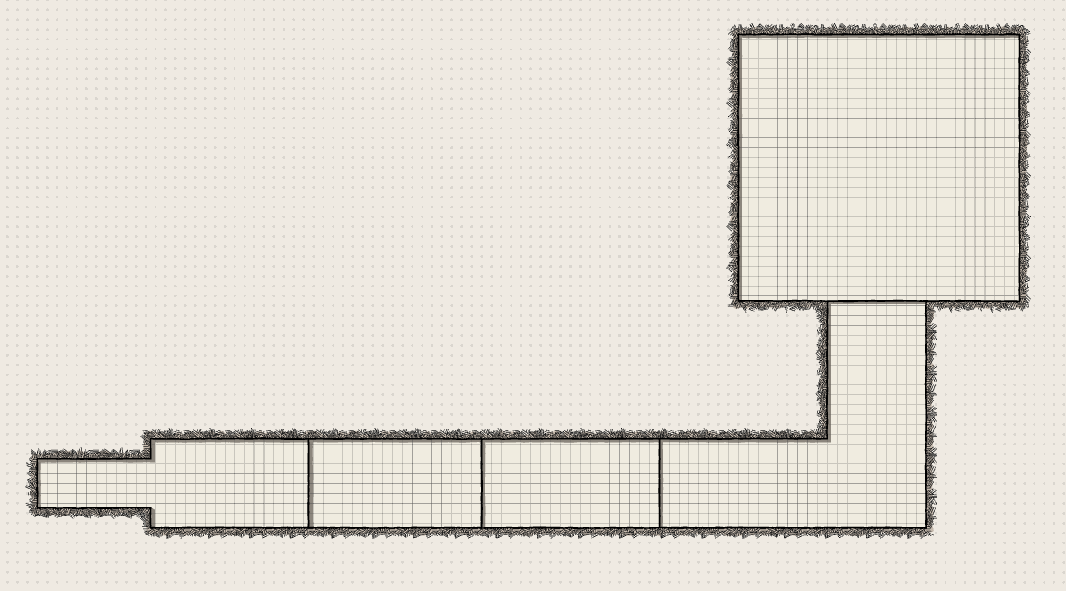
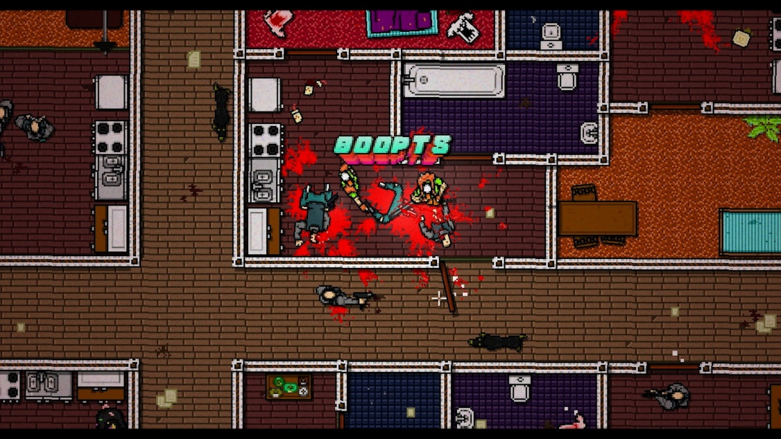
Level Implementation & Research
Fast paced, familiar, complex and compact, keeps players unaware and on toes
Keeps player moving, keeps gameplay flowing and engaging
Set in abandoned backrooms of hotel, small scale rooms and strange visual look make engaging and intriguing
Enemies placed to test reaction time, varying amounts, deter player from certain routes
Tutorial Design Sketch
1st Level Design Sketch
Notes:
To compliment the fast-paced gameplay we went for, I decided to design a level that would feel familiar for a player to move through, yet complex and compact enough with many rooms to keep the player on their toes and unaware of where and how enemies will come at them.
The level is designed to keep the player moving, therefore keeping the gameplay flowing and constantly engaging.
I decided that the most appropriate location for the level to be set in was the abandoned backrooms of a hotel, as the scaling of the rooms and strange visual look would offer a unique and intriguing experience for the player.
The enemies are placed in spots that will challenge the player’s reaction time while not being too fast or difficult for the player so that they are not put off from playing. There are varying amounts of enemies in each room, and some are placed to deter the player from going certain routes.

Slide 13
Conclusions:
Accomplishments:
Goal
Core gameplay
Key Mechanics
Close Quarters level feeling
Feedback Response
Problem Solving
Improvements:
Variety
Enemy Variety (bosses)
Weapons
Gamemodes
Mechanics
Equipment/Carrying
Area/Costume customization
Environment interactions
Polish
Knockback
Game feel
Feedback
Notes:
Accomplished
Goal – we wanted to make
Improvements
Variety:
Dynamic and fast is challenging at first but like all things you get used to it. Our priority for improvements is providing players with more unique challenges and approaches for instance:
enemy variety – different looks, weapons/equipment, etc
friendly fire – helps add variety when melee enemies' gang up on the player, and entertaining
Items – for the player and enemies to use (e.g., Trolly, Taser, Glass)
Zeus – AI boss enemy – more health – lighting stun attacks – gives taser on defeat
Boss variety
Equipment Mechanic:
With varies items to use we would need to implement an equipment mechanic for
We wouldn’t need many buttons, so we could bind each equip key to corelating socket
We would also use this to implement the ability to pick up enemy corpses
Then give enemies this mechanic as well but change the players loss condition to the trashcan condition
Area Claiming Mechanic:
Story wise the player is a new contestant fighting veteran contestants that were given their own areas, it stands to reason the player should get their own as well.
Two ways I see it working (maybe do both) allows players to either make a level for other players to challenge, or let each stage be used as communal areas after completion that the players can use as hubs to talk to NPC's with
Costumes:
The enemies are in costume, why not the player too (the only reason is lack of time and resources)
Could even unlock costume pieces from enemies the player defeats
Polish:
These are in game, but could use refining to meet our intention
Interaction:
We want to include various Environment interactions, so the player has more unique options throughout the levels: scattered items, moveable objects, obstacles, etc
Game to player feedback:
Ways the game will convey information to the player
Combat
Ragdolls need to be Obvious
Ideally sound effect indicate impact/damage
Progress indicators
An enemy count could work
Announcer comments
Boss Talks

Slide 14
How our teamwork could improve
Process improvements:
Team lead could have checked in less often
More frequent document updates
Better prioritization of tasks
Plan countermeasures for sickness
More frequent/consistent meetings
Communication via software/online

Slide 15
Questions and Recomendations?
Notes:
How is this different from other top-downs?
How would you sell/monetize this?
What's your unique selling point?
What problems did you encounter/deal with?
Why this mechanic?
How would you improve it?

